Slide 1
Great Truths about
Revenue Management Systems brought to us by various cartoonists
Notes:
I want to contribute to a subject introduced by famous Mr. Bill Brunger: Revenue Management humor. Some time ago I got an e-mail with ‚great truths about life‘ brought to us by children. Truths like
Wear a hat when feeding seagulls.
Don't ever be too full for dessert.
School lunches stick to the wall.
You can't trust dogs to watch your food.
You can't hide a piece of broccoli in a glass of milk.
I adopted this idea and came up with great truth about Revenue Management systems brought to us by various cartoonists.

Slide 2
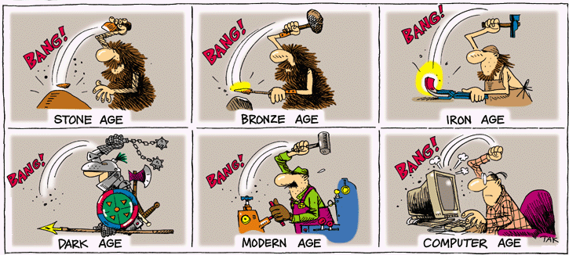
Nothing can stop automation

Slide 3
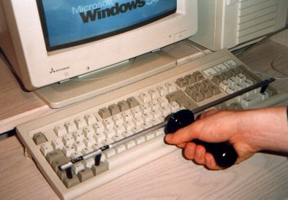
Computer tools make work easier

Slide 4

Don‘t chase the cheapest product
Your trial period is over
Please register now
OK

Slide 5

Don‘t set too ambitious deadlines
Deadline is deadline !

Slide 6
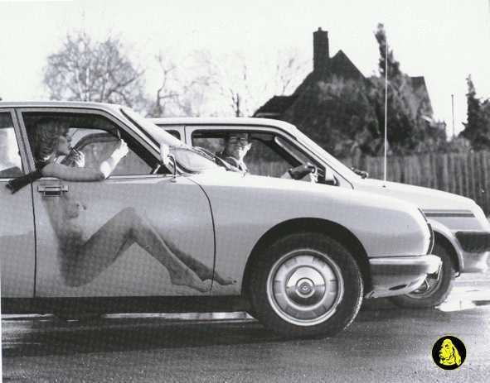
A nice GUI often hides a lack of functionality

Slide 7
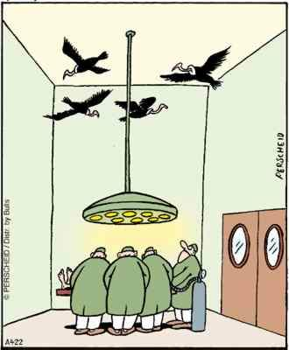
Always listen to the market

Slide 8
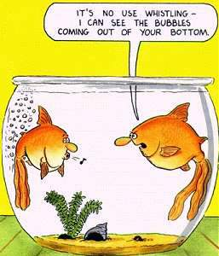
You can‘t hide any bug from users
It‘s no use whistling –
I can see the bubbles coming
out of your bottom.

Slide 9

Users don‘t like bugs
O.k., and now you‘ll do
exactly what I‘m telling you !
Access
denied

Slide 10
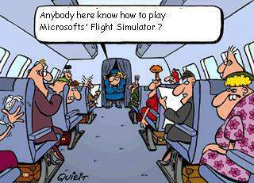
Simulation expertice helps

Slide 11
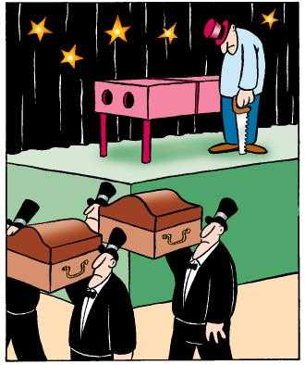
Not every presentation is successful

Slide 12
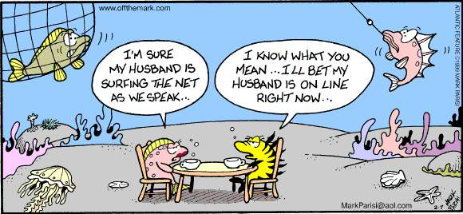
Web-ability is a must

Slide 13

What suits one customer might not suit the next

Slide 14
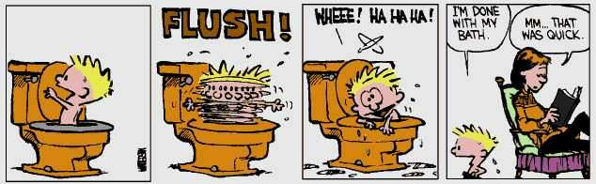
Look for efficient solutions

Slide 15

Support different situations by specific tools

Slide 16

Build in a help function

Slide 17
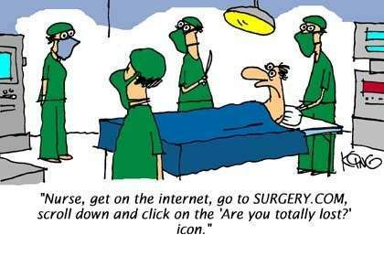
On-line help can be useful

Slide 18

Forecasting and optimization are complex
Come on! It can‘t go
wrong every time...

Slide 19

Select significant attributes for your forecaster
Which one
Is mine?

Slide 20
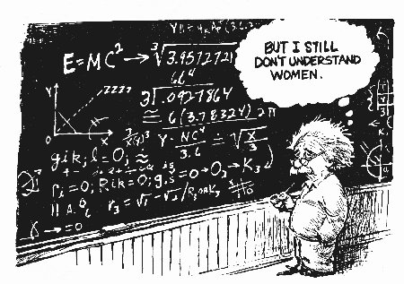
Maths is not everything

Slide 21
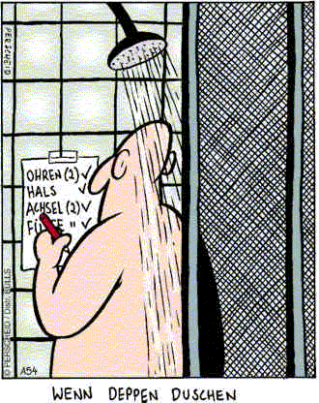
Use check-lists for testing
ears
neck
feet

